Slide 1


FFSD Project Group-37

Slide 2


Online Vehicle Parking Reservation System
Team Members
.Sahil Kasare (S20220010191)
Sushant Gadyal (S20220010218)
Yadnyesh Badgujar (S20220010247)
Vighnesh Barage (S20220010033)
Hrishikesh Dongre (S20220010083)

Slide 3
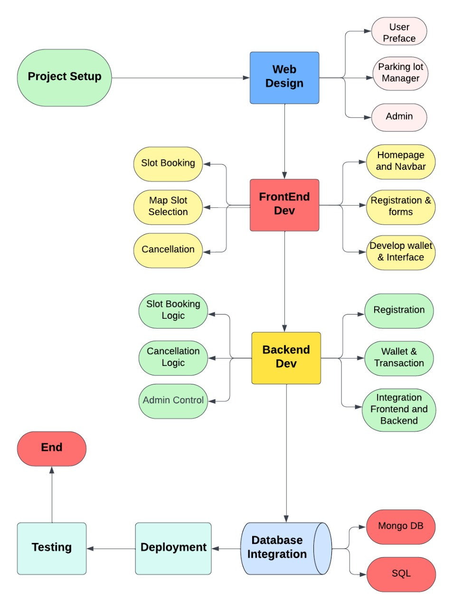
Work Plan Flowchart

Slide 4
Implementation Plan
First Part: Frontend Development and JavaScript Implementation
User Interface Development:
Design and implement user registration and login pages with appropriate forms and validation.
Develop user profile management pages for updating personal information and viewing booking history.
Create responsive and user-friendly interfaces for easy navigation and interaction.
Lot Manager Interface Development:
Design dedicated pages for lot managers to view parking lot details, such as capacity, location, and pricing.
Implement interfaces for lot managers to manage parking lot availability, add or remove slots, and update pricing.
Develop a dashboard for lot managers to monitor booking activities, view occupancy rates, and generate reports.
Admin Interface Development:
Design an admin dashboard with access to system-wide settings and controls.
Implement interfaces for admin tasks such as user management (view, edit, delete users), lot management (add, edit, delete parking lots), and revenue tracking.
Create interfaces for generating reports on user activities, booking statistics, and revenue analytics.

Slide 5
Second Part: Backend Development and Database Integration
User Authentication and Authorization:
Implement authentication logic for users, allowing them to register, login, and securely access their accounts.
Develop authorization mechanisms to restrict access to certain pages and functionalities based on user roles.
Lot Manager Functionality:
Implement backend logic for lot managers to manage parking lot details, including CRUD operations for parking slots and pricing.
Design APIs for lot managers to view booking details, update slot availability, and receive notifications.
Admin Functionality:
Develop backend functionality to support admin tasks such as user management, lot management, and revenue tracking.
Implement APIs for admins to view system-wide data, generate reports, and modify system configurations.
Database Integration:
Set up MongoDB or another suitable database to store user data, parking lot details, booking information, and system configurations.
Design database schemas to efficiently manage data for users, parking lots, bookings, and admin settings.
Implement CRUD operations and database queries to interact with the database from the backend server.

